Slide 1
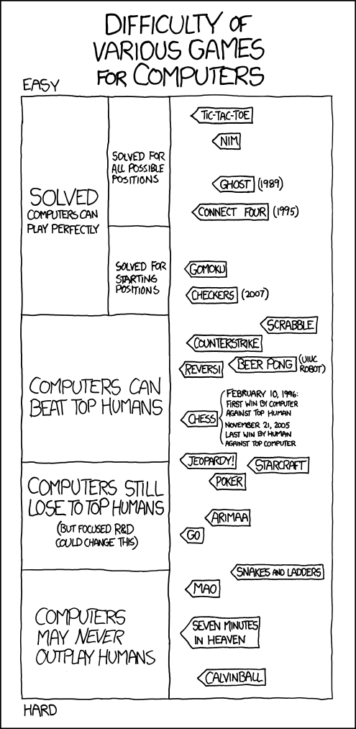
Distributed Q-Learning: A Democratic Learning Process
by Max Robinson
https://xkcd.com/1002/`
Notes:
To change the image on this slide, select the picture and delete it. Then click the Pictures icon in the placeholder to insert your own image.

Slide 2
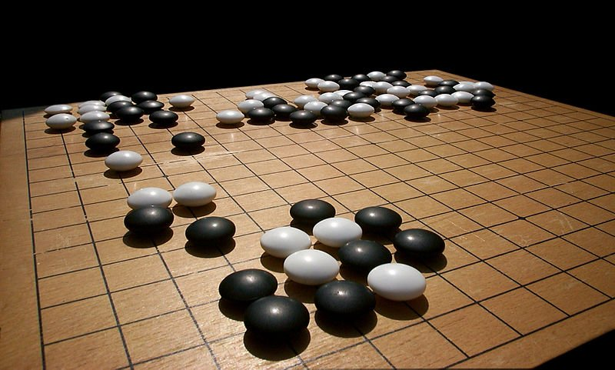
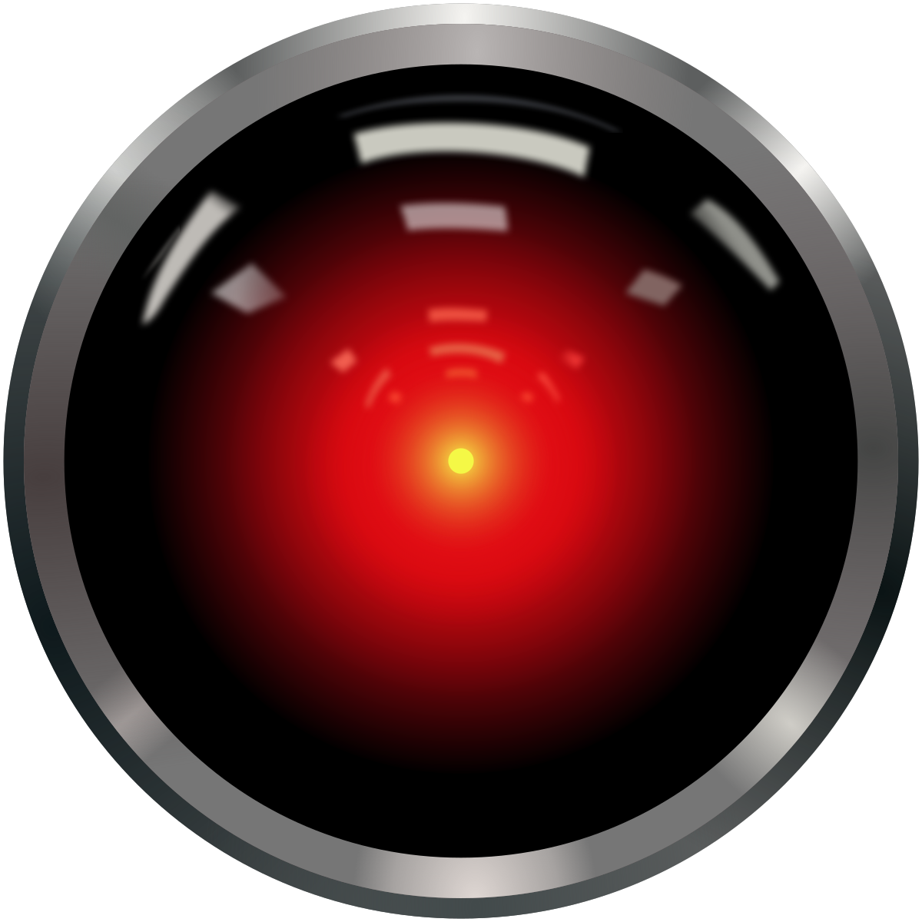
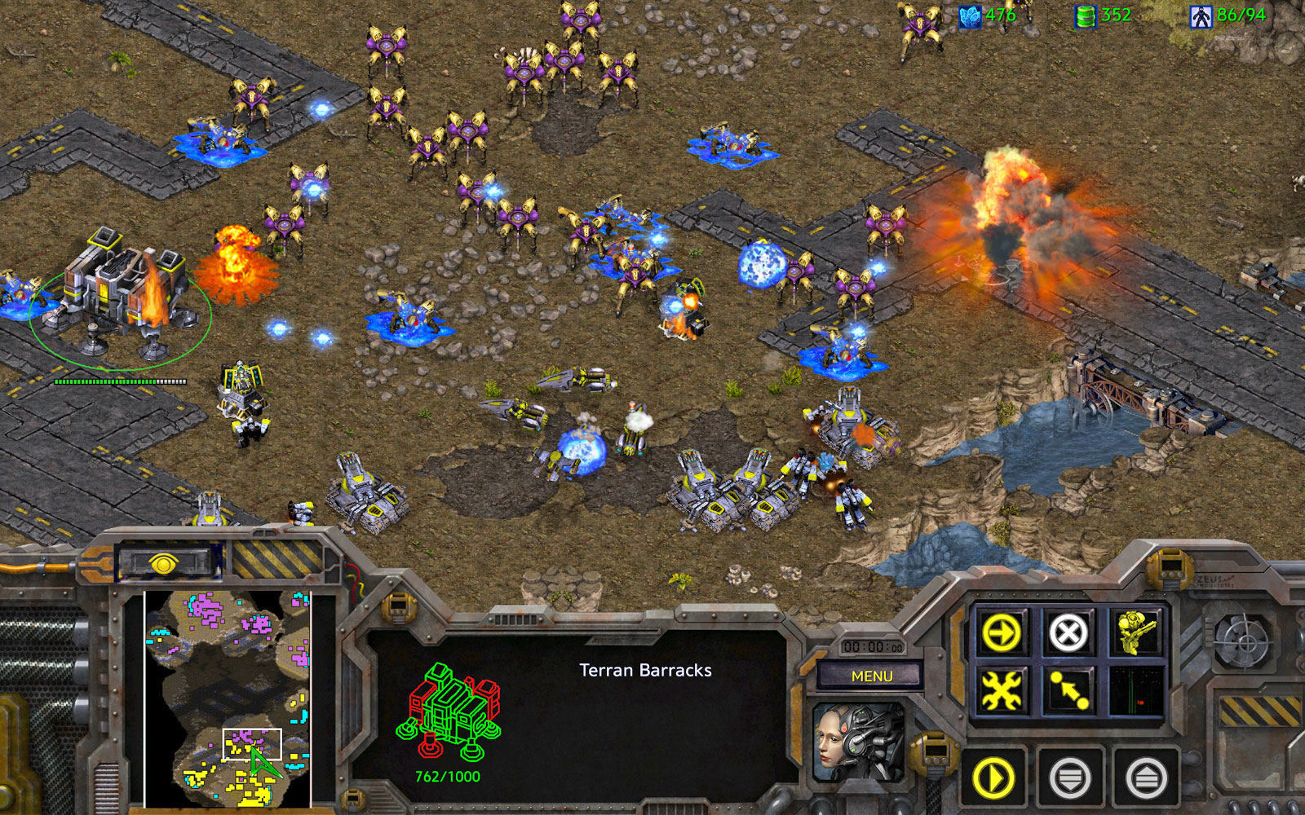
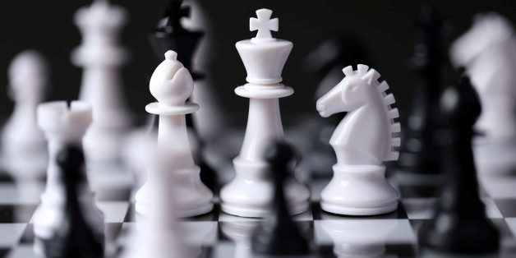
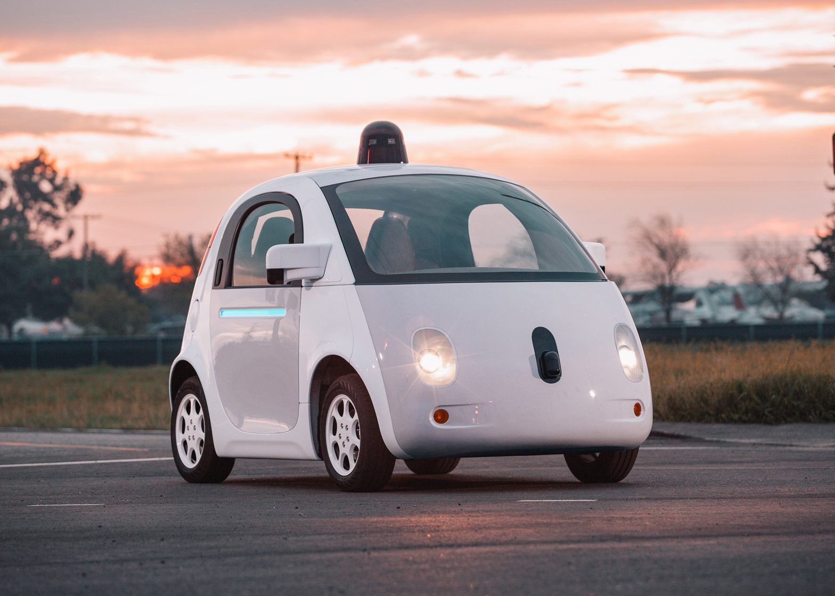
Why Reinforcement Learning?
Notes:
http://www.businessinsider.com/go-board-game-in-demand-after-google-deepmind-put-it-in-the-spotlight-2016-4?r=UK&IR=T
https://www.engadget.com/2017/03/26/starcraft-remastered/
http://www.unb.com.bd/sports-news/K-Kundu-leading-in-Sonargaon-Intl-FIDE-Rating-Chess/66315
https://en.wikipedia.org/wiki/HAL_9000
https://www.dezeen.com/2016/02/12/google-self-driving-car-artficial-intelligence-system-recognised-as-driver-usa/

Slide 3
Reinforcement Learning
State
Action
Observation & Reward

Slide 4
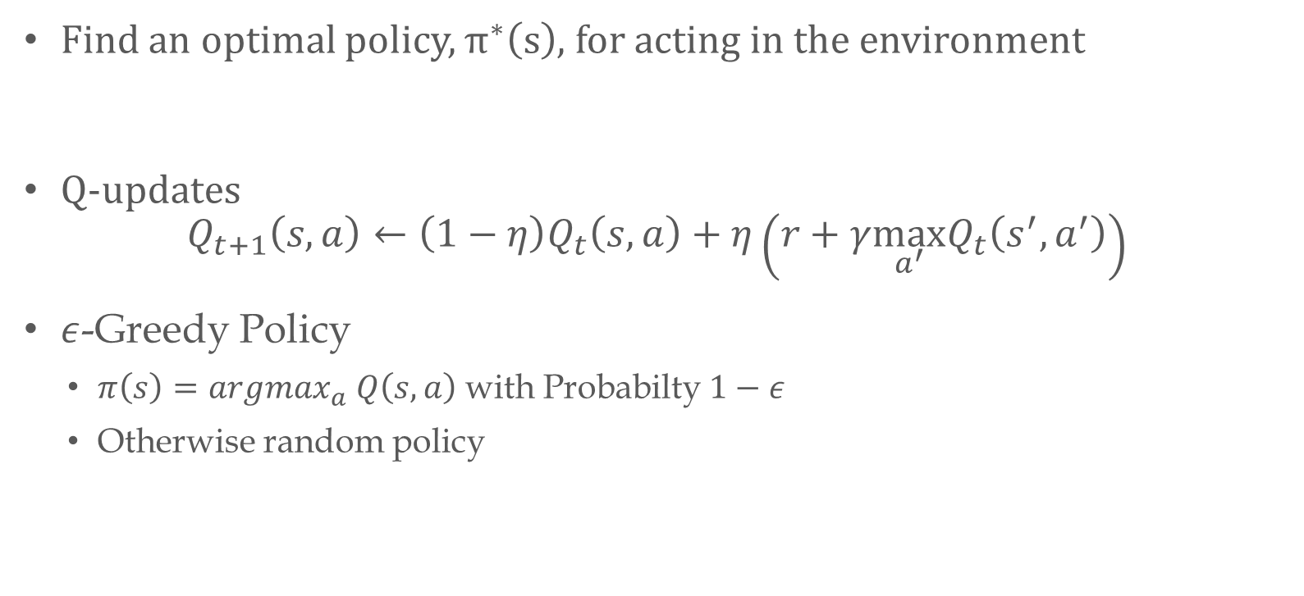
Q…-learning?
Find an optimal policy, $π^{∗}\left(s\right)$, for acting in the environment
Q-updates
$$Q_{t+1}\left(s,a\right)←\left(1−η\right)Q_{t}\left(s,a\right)+η\left(r+γ\max_{a^{′}}Q_{t}\left(s^{′}, a^{′}\right)\right)$$
$ε$-Greedy Policy
$π\left(s\right)=argmax_{a} Q\left(s,a\right)$ with Probabilty$1−ε$
Otherwise random policy

Slide 5
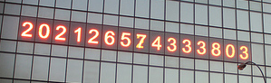
So what is wrong? Why distributed?
Number of episodes required for single agent can be very large
Experience is sequential for a single agent
Could decrease number of episodes for a single agent
Flexibility in experience and exploration
Can decrease time training episodes required for individual agent
Notes:
https://untappedcities.com/2013/10/08/daily-what-what-are-those-numbers-counting-in-union-square/

Slide 6
Previous Work
Asynchronous updates can still maintain Q-learning optimality (Tsitsiklis, 1994)
Multi-agents with a single Q-table (Mannion et al. 2015)
General Reinforcement Learning Architecture (Gorila) (Nair et al. 2015)

Slide 7
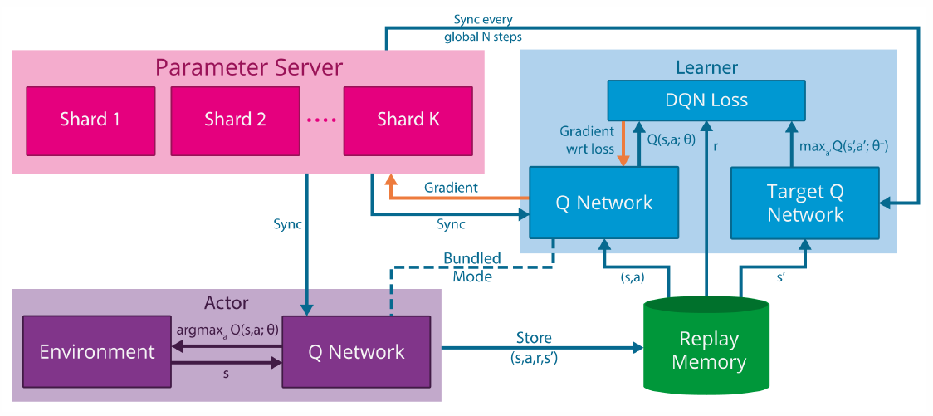
Example: Gorila Architecture

Slide 8
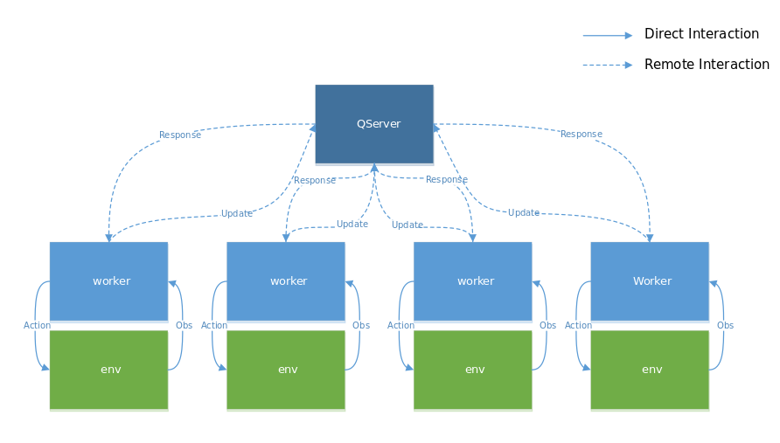
Distributed Q-learning: DistQL

Slide 9
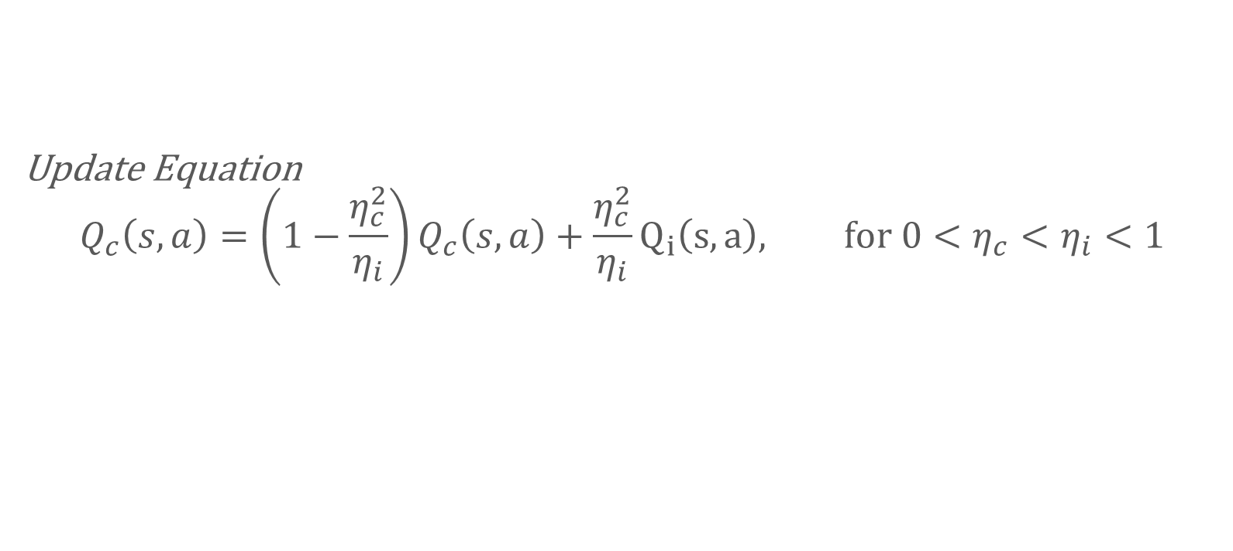
DistQL Details
Update Equation
$$Q_{c}\left(s,a\right)=\left(1−\frac{η_{c}^{2}}{η_{i}}\right)Q_{c}\left(s,a\right)+\frac{η_{c}^{2}}{η_{i}}Q_{i}\left(s,a\right), for 0<η_{c}<η_{i}<1$$

Slide 10
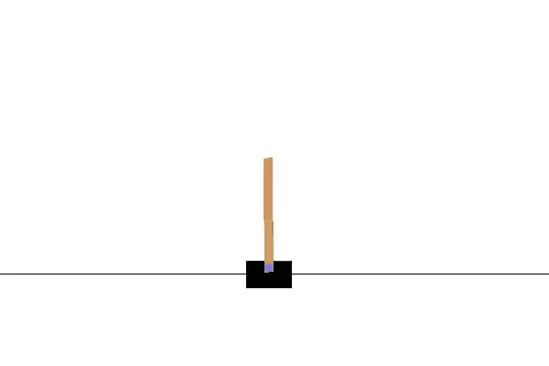
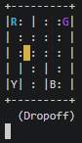
Experiments

Slide 11
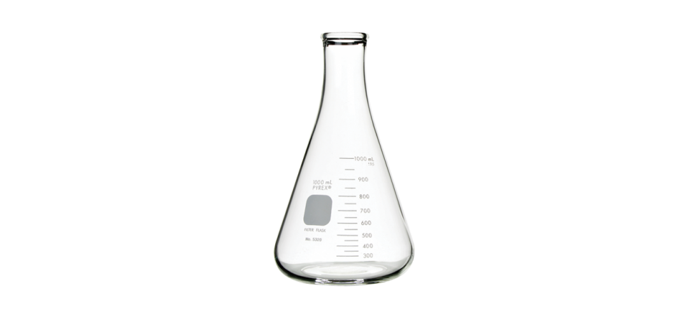
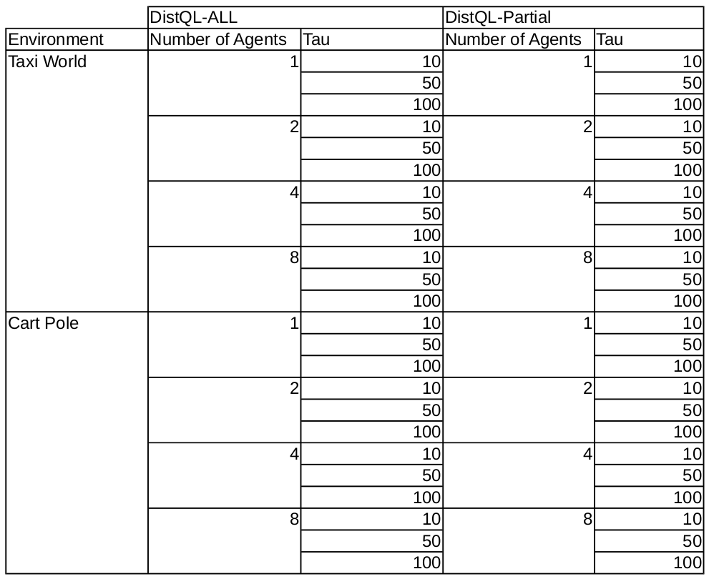
Experiments Enumerated
42!!! Errr... I mean 48
Notes:
https://www.humboldtmfg.com/erlenmeyer-flask.html

Slide 12
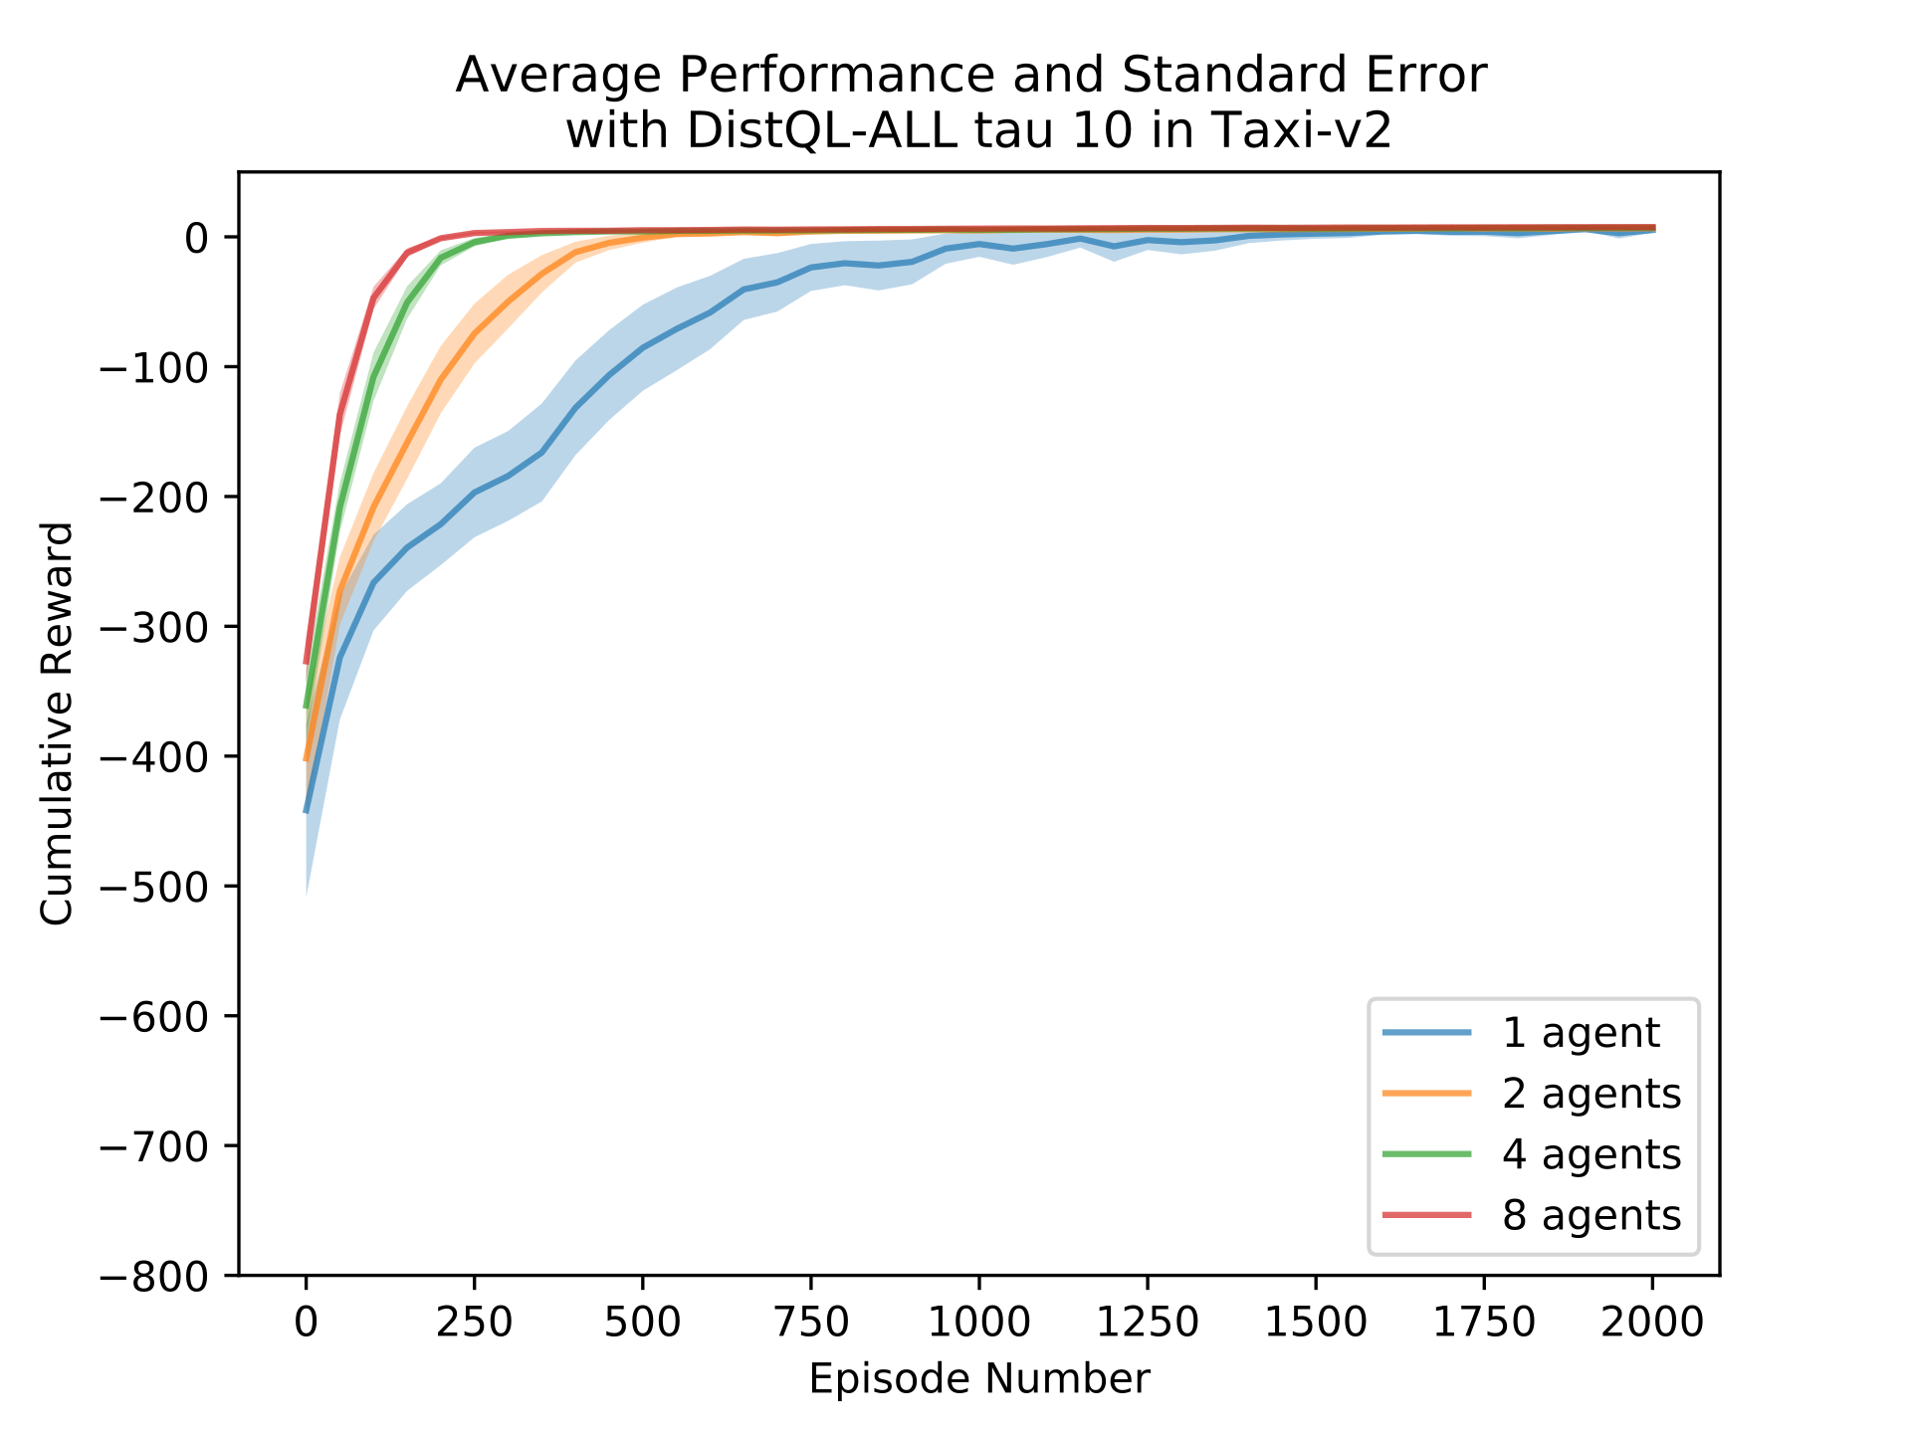
So how did we do?

Slide 13
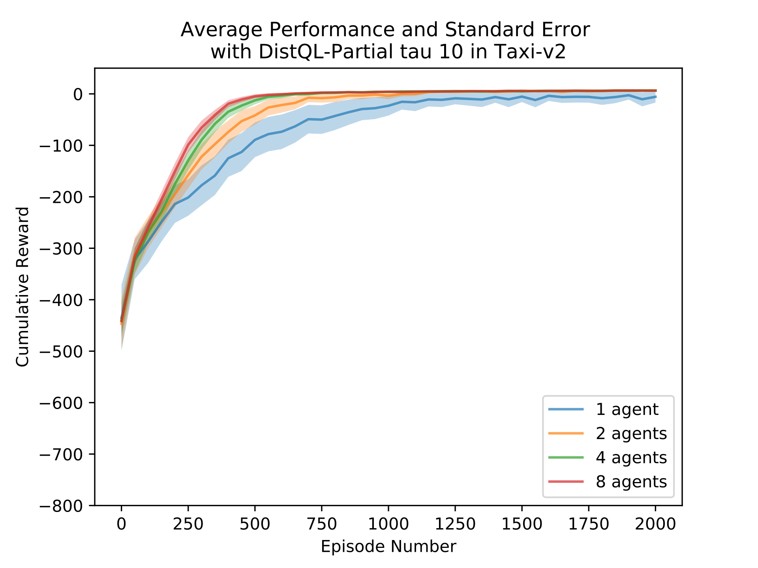
DistQL-ALL vs DistQL-Partial Taxi World

Slide 14
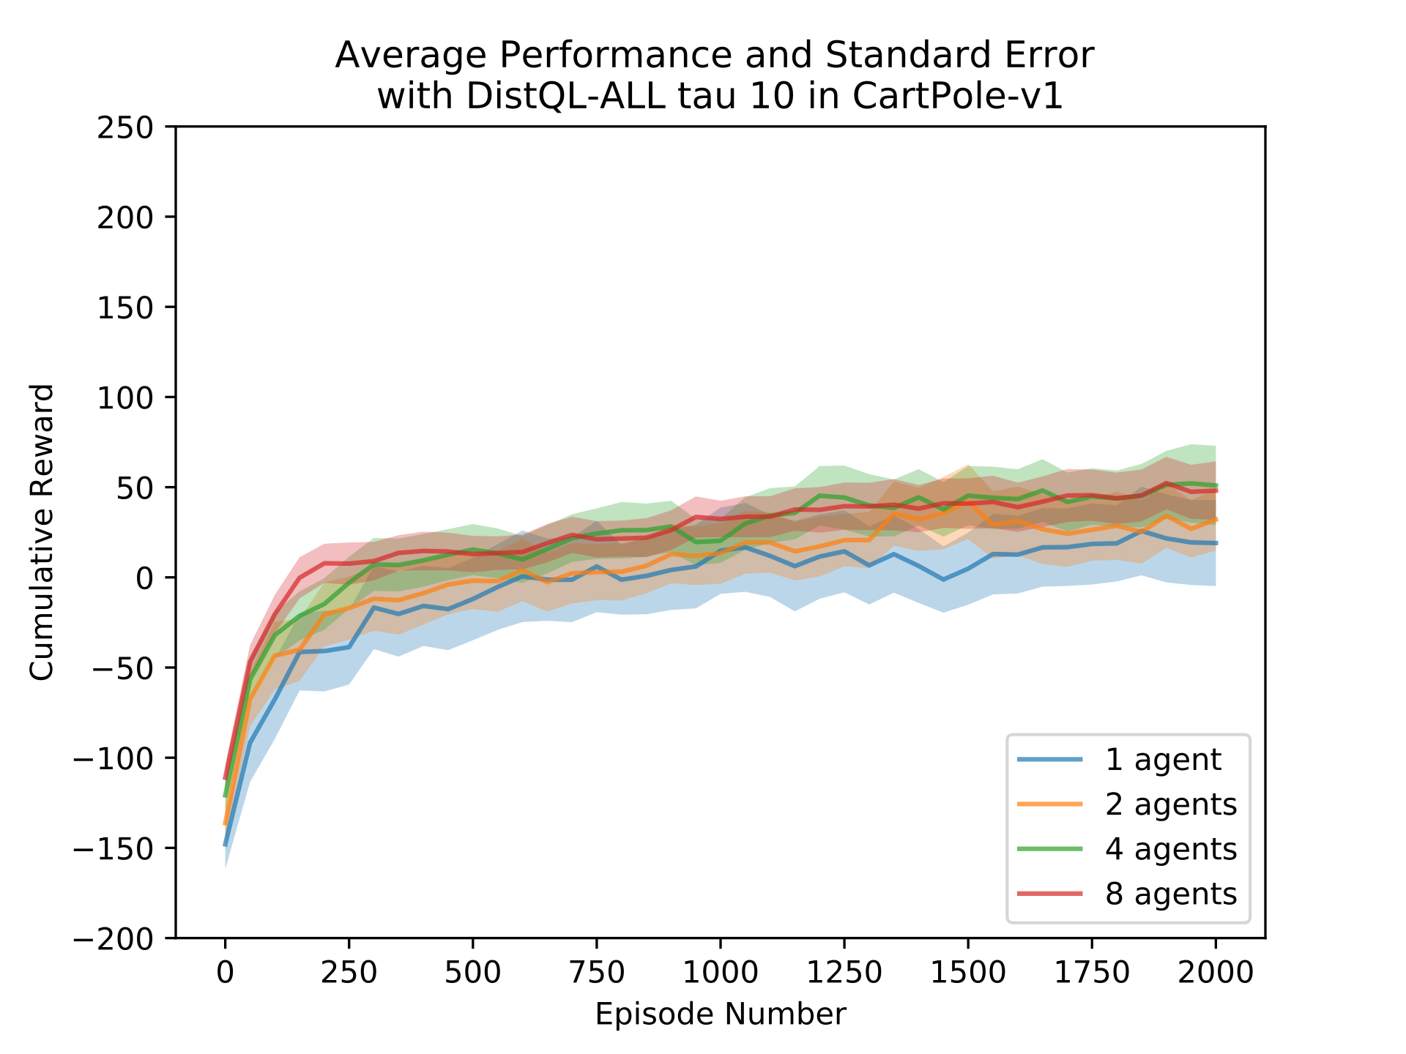
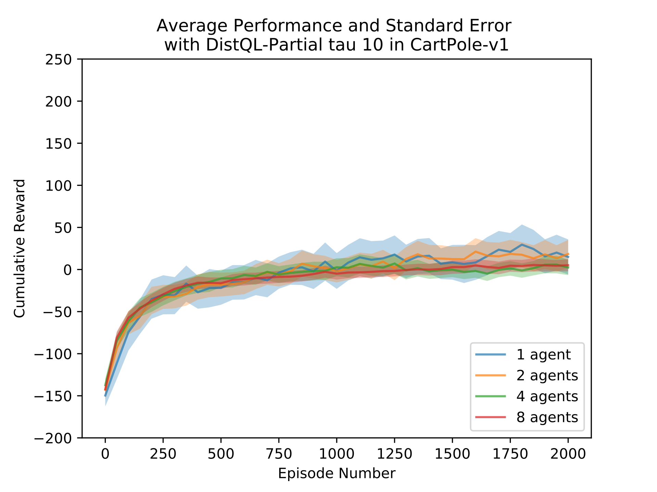
DistQL-ALL vs DistQL-Partial Cart Pole

Slide 15
Future Work

Slide 16
References
Tsitsiklis, J. N. (1994). Asynchronous stochastic approximation and q- learning. Machine Learning, 16 (3), 185-202.

